Slide 1
AHRQ Leadership on Evidence to Transform Care
Arlene Bierman, M.D., M.S.
Chief Strategy Officer
Agency for Healthcare Research and Quality
Northern Virginia Health Policy Forum
July 17, 2024

Slide 2
Agency for Health Care Research and Quality (AHRQ) Mission
To produce evidence to make health care safer, higher quality, more accessible, equitable and affordable
To work with HHS and other partners to make sure that the evidence is understood and used
www.ahrq.gov

Slide 3
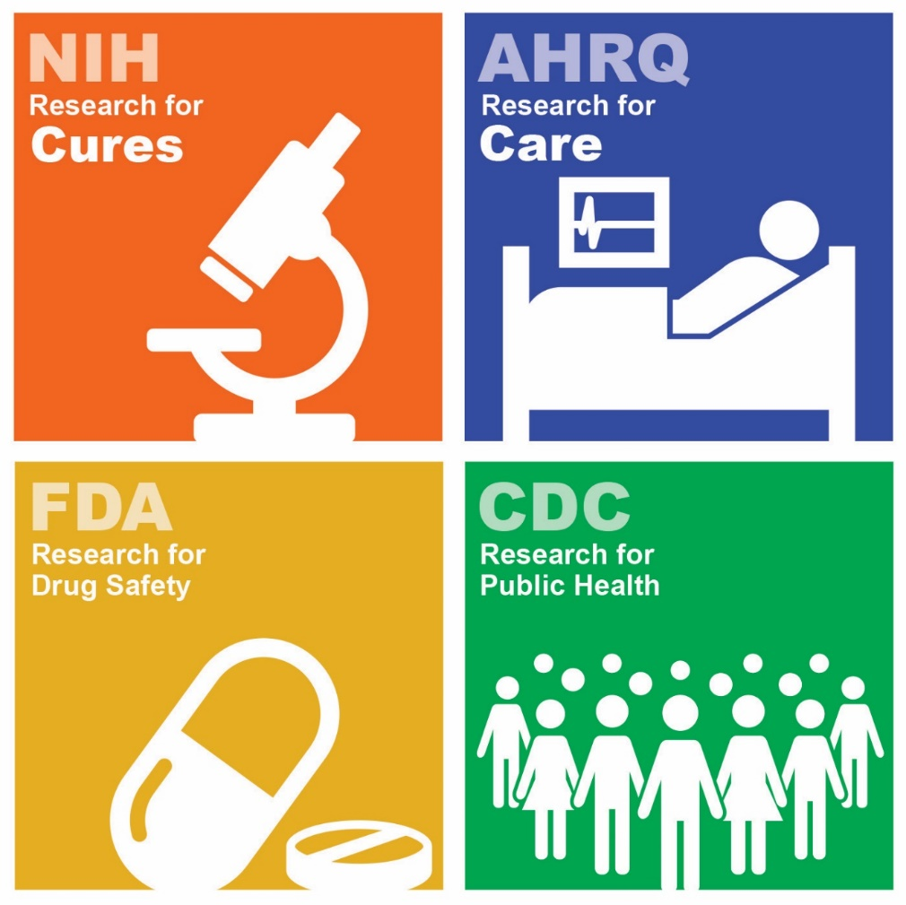
AHRQ’s Unique Federal Role
Making 21st century CARE a reality for all requires multiple pathways
Biomedical discoveries necessary but insufficient
AHRQ’s authorities: healthcare improvement
Generate scientific Evidence
Disseminate and help implement Actionable Knowledge
Improve Primary Care
Partner with patients and private sector
AHRQ is to healthcare systems as
CDC is to public health systems

Slide 4
AHRQ’s Priorities

Slide 5
From Disease Specific to Person-Centered Care
“Person-centered care” means that individuals’ values and preferences are elicited and, once expressed, guide all aspects of their health care, supporting their realistic health and life goals. Person-centered care is achieved through a dynamic relationship among individuals, others who are important to them, and all relevant providers. This collaboration informs decision-making to the extent that the individual desires.
“Person-Centered Care: A Definition and Essential Elements” The American Geriatrics Society Expert Panel on Person-Centered Care, December 2015
https://www.ncbi.nlm.nih.gov/pubmed/26626262

Slide 6
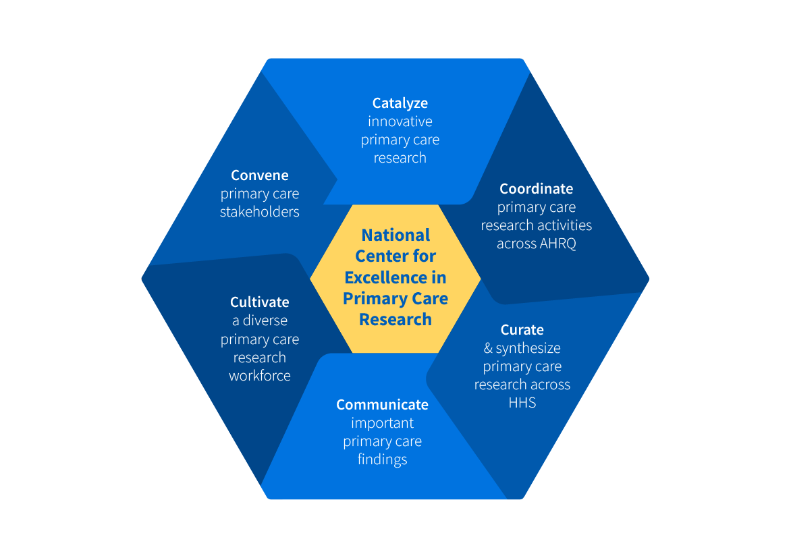
NCEPCR Vision & Mission
VISION:
NCEPCR envisions a future where all patients receive high quality, whole person, evidence-based, affordable primary health care from a healthy primary care workforce.
MISSION:
NCEPCR’s mission is to support transformative primary care research, tools and methods for implementation, and the next generation of primary care researchers to improve the delivery of primary care.

Slide 7
Primary Care Funding Opportunities
Small Research Projects to Advance the Science of Primary Care (R03)
to support small research projects that advance the understanding of the role and capacity of primary care to increase the value and quality of care and improve patient outcomes and population health by delivering person-centered care.
Research to Advance the Science of Primary Care (R01)
to build evidence about the characteristics and value of primary care that influence patient outcomes and advance health equity, such as care coordination, continuity of care, and comprehensiveness of care, person-centered, whole healthcare, and trust, and how these can be improved and effectively delivered to strengthen primary healthcare.

Slide 8
The Integration Academy

Slide 9
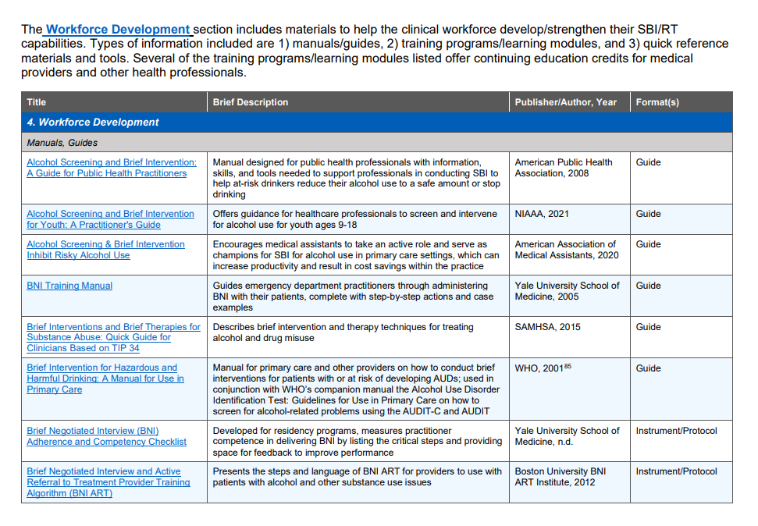
New Resources for Managing Unhealthy Alcohol Use
https://integrationacademy.ahrq.gov/about/initiatives/alcohol

Slide 10
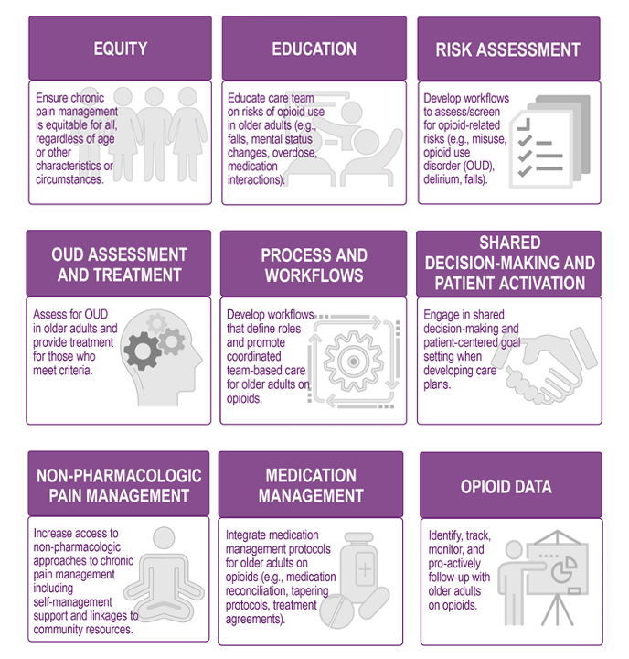
Change package for improving management of opioids in older adults
https://integrationacademy.ahrq.gov/about/initiatives/older-adult-opioid-initiative

Slide 11
AHRQ’s Healthcare Extension Service
Goals
Accelerate the dissemination and implementation of PCOR evidence into practice
Reduce healthcare disparities among Medicaid beneficiaries, uninsured, and medically underserved
Notice of Information to Publish Notice of Funding Opportunity (NOFO) Announcements for AHRQ’s Healthcare Extension Service to Accelerate Implementation of Patient-Centered Outcome Research Evidence into Practice
Published June 6, highlighted 3 components
State-based Healthcare Cooperatives
A National Coordinating Center
A National Evaluation Center

Slide 12
The Challenge: Demographics and Population Health (or the why)
The U.S. population is aging but our health system is woefully unprepared
The population age 65 and older increased from 40.3 million in 2010 to 55.8 million in 2020 (a 38.6% increase) and is projected to reach 94.7 million in 2060
Life expectancy and activity life expectancy are declining as inequities on these measures associated with race/ethnicity and socioeconomic position are widening
Low income and minority individuals age faster (weathering)
Much of this morbidity and mortality is preventable

Slide 13
The Challenge of Multiple Chronic Conditions
Disease-specific vs. person-centered approaches. Disease-specific approach to care delivery and research is misaligned with the whole person-centered needs of patients and caregivers.
Interoperability obstacles in complex care. People with MCC require care in multiple settings, from multiple providers. Data do not easily move across settings of care.
Health equity. People from low-income backgrounds and under-represented racial or ethnic groups develop MCC at higher rates and earlier ages.
1IN 3
NEARLY
4 IN 5
&
People with MCC account for:
American Adults
Medicare Beneficiaries
64%
70%
83%
71%
93%
ARE LIVING WITH MCC, THE MOST COMMON CHRONIC CONDITION
OF ALL
Clinician Visits
OF ALL
In-Patient Stays
OF ALL
Prescriptions
OF ALL
Healthcare Spending
OF ALL
Medicare Spending
CMS 2018: https://www.cms.gov/data-research/statistics-trends-and-reports/chronic-conditions/chartbook-and-charts;
AHRQ 2010: https://www.ahrq.gov/sites/default/files/wysiwyg/professionals/prevention-chronic-care/decision/mcc/mccchartbook.pdf;
Quiñones, et al. Racial/ethnic differences in multimorbidity development and chronic disease accumulation for middle-aged adults. PLoS One, 2019;14(6), PMID: 31206556
Bierman et al, Transforming care for people with multiple chronic conditions: Agency for Healthcare Research and Quality's research agenda https://www.ncbi.nlm.nih.gov/pmc/articles/PMC8515222/pdf/HESR-56-973.pdf HSR, 2021
.

Slide 14
AHRQ’s Strategic Plan: Advancing Health System Transformation to Optimize Health, Functional Status, and Well-being among Older Adults
Vision: All Americans receive high-quality person-centered care based in primary care that optimizes health, functional status, and well-being as they age, and advances health equity.
Support health system transformation by funding research to develop, implement, evaluate, and scale person-centered models of care to optimize physical and mental health, functional status, and well-being among older adults for individuals and populations.
Disseminate and implement evidence to improve health outcomes and experience of care of older adults.
Support training and mentoring of health services researchers with expertise in improving care delivery for older adults.
Expand and create synergies across AHRQ’s portfolio to support health system transformation to improve care quality such that it is timely, equitably distributed, safe, and effective, leading to better health and well-being for older adults and widely communicate that aging is a priority of AHRQ to internal and external audiences.
Develop strong federal, health system, public health, and private sector partnerships to transform health care delivery to meet the needs of an aging population.

Slide 15
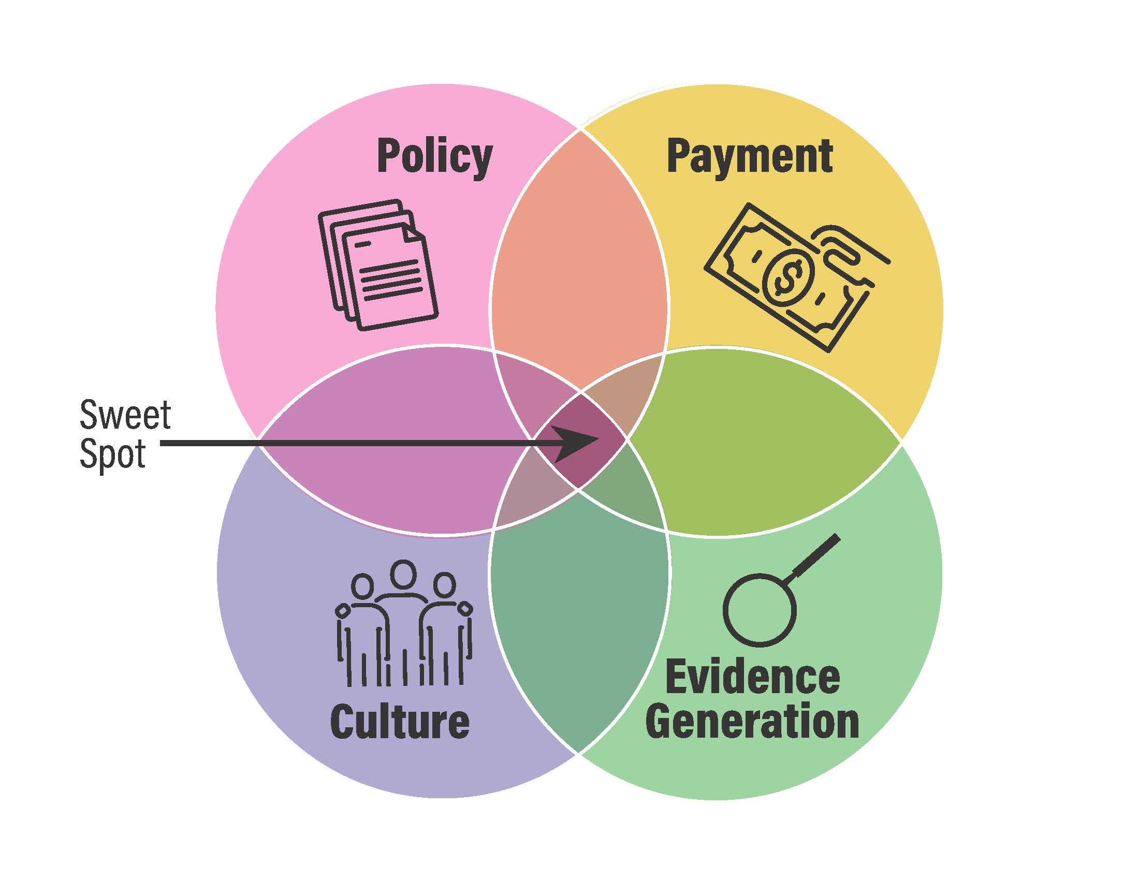
Health System Transformation and Aging Well The “Sweet Spot”

Slide 16
NEW: Special Emphasis Notice (SEN) Improving Care for Older Adults
Health Services Research to Improve Care Delivery, Access, Quality, Equity, and Health Outcomes for Older Adults” https://grants.nih.gov/grants/guide/notice-files/NOT-HS-24-013.html
This SEN conveys AHRQ’s interest in supporting health services research to conduct research that will address questions related to the development, implementation, evaluation, and scale of person-centered models of care to optimize physical and mental health, functional status, and the well-being among older adults. This SEN builds on AHRQ’s prior work, including the Optimizing Health and Function as We Age Roundtable Report , Research Agenda for Transforming Care for People with Multiple Chronic Conditions, and the Multiple Chronic Conditions e-careplan. It also supports AHRQ’s ongoing commitment to the inclusion of priority populations in health services research (About Priority Populations | Agency for Healthcare Research and Quality (ahrq.gov).

Slide 17
Person-Centered Care Planning Initiative
Partner Engagement and Learning Community
Gather knowledge about the current state of person-centered care planning in practice, including person-centered care planning models in use across diverse health systems, practices, and settings; scale of existing models; implementation barriers and facilitators; and feasible solutions to implementation barriers;
Identify innovative, feasible models of person-centered care planning that hold promise for further development, testing, dissemination, and implementation;
Identify innovative digital solutions that have been leveraged as tools to support and facilitate the success of implementing person centered care planning in practice;
Identify key organizational, policy, payment, technology, cost, and resource requirements for implementing person-centered care planning across diverse health systems, practices, and settings; and
Identify key research priorities, strategies, recommendations, and next steps to advance AHRQ’s mission of disseminating and implementing person-centered care planning as routine and integral practice in the care of persons with MCC.

Slide 18
Alignment with Department and Administration Priorities
The U.S. Playbook to Address Social Determinants of Health
https://www.whitehouse.gov/wp-content/uploads/2023/11/SDOH-Playbook-4.pdf
Improving Health And Well-Being Through Community Care Hubs https://www.healthaffairs.org/content/forefront/improving-health-and-well-being-through-community-care-hubs
HHS Call to Action Addressing Health-Related Social Needs in Communities Across the Nation https://aspe.hhs.gov/sites/default/files/documents/3e2f6140d0087435cc6832bf8cf32618/hhs-call-to-action-health-related-social-needs.pdf
Report to Congress - Aging in the United States: A Strategic Framework for a National Plan on Aging
https://acl.gov/sites/default/files/ICC-Aging/StrategicFramework-NationalPlanOnAging-2024.pdf

Slide 19
AHRQ/NIDDK eCare Plan for Multiple Chronic Conditions (MCC) Project
Build capacity for pragmatic, patient-centered outcomes research (PCOR) by developing an interoperable electronic care plan to facilitate aggregation and sharing of critical patient-centered data across home-, community-, clinic-, and research- based settings for people with multiple chronic conditions (MCC).
https://ecareplan.ahrq.gov/collaborate/
Notes:
This brings us to the purpose and scope of the eCare Plan for Multiple Chronic Conditions (or MCC) Project.
We are here to build capacity for pragmatic, patient-centered outcomes research by
developing an interoperable electronic care plan
to facilitate aggregation and sharing of critical patient-centered data
across home, community, clinic and research based settings
for people with multiple chronic conditions.
The Confluence link for this project is included below.

Slide 20
Comprehensive Standards-Based eCare Planning
Notes:
https://cmext.ahrq.gov/confluence/pages/viewpage.action?pageId=109248868&preview=/109248868/109249322/MCC%20eCare%20Plan%20TEP%20Monthly%20Meeting%2018NOV21.pdf

Slide 21
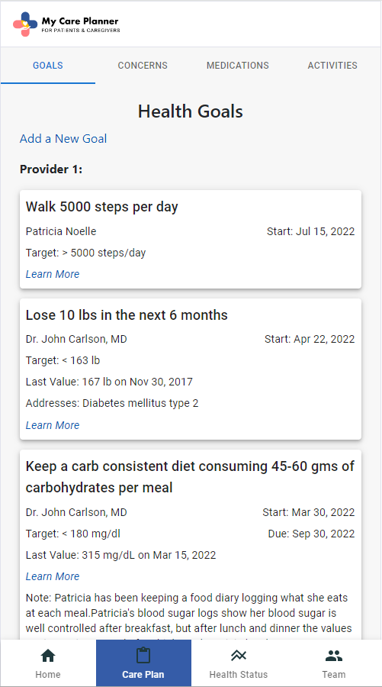
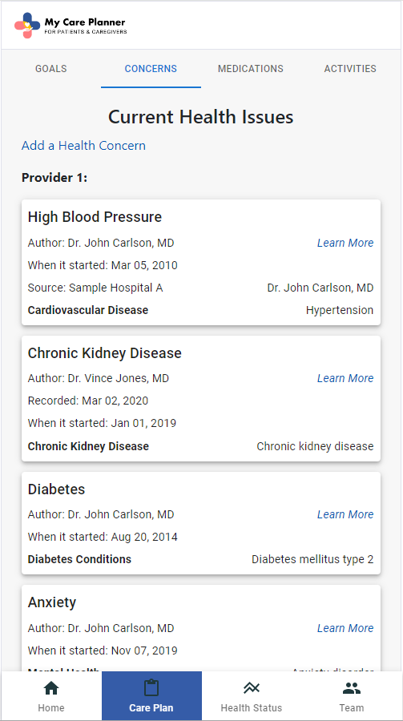
Goal-Oriented Care Planning
Place a person’s goals at the center of decision-making
Cross-platform web application
JavaScript React app
Formatted for mobile device browsers
Current integration in pilot:
Epic, Cerner, VA, NextGen, AthenaPractice

Slide 22
Caminante, no hay camino, se hace camino al andar.
Antonio Machado
Traveler, there is
no path,
we make the path by walking

